Slide 1

Object Oriented Programming Methodology Case Study
Ticket Booking System
Team Name – Visual programmers​
Team Members – 3rd Sem​
Leader Name : Sandeep Sen​
Sandeep Sen 0131CS221172​
Utkarsh Sahu 0131CS221219​
Saurabh Sahu 0131CS221182​
Visual Programmers
Prof. B.M. Sharma

Slide 2
Need of Ticket Booking System
Online movie ticket booking systems offer convenience and hassle-free methods to purchase tickets.
Traditional methods of purchasing tickets can be time-consuming and inefficient.
Online systems provide real-time information on ticket availability and pricing.
Mobile ticketing eliminates the need for printed tickets and enhances the overall user experience.

Slide 3
Study of Ticket Booking System
Online movie ticket booking systems have become increasingly popular in recent years.
These systems offer a variety of features and benefits to both customers and businesses.
It is important to understand the different types of online movie ticket booking systems available.
It is also important to consider the security and reliability of these systems.

Slide 4
Advantages and Disadvantages of ticket booking system
Disadvantages
Advantage
Convenience
Choice and seating flexibility
Real-time availability and pricing
Payment options and security
Mobile ticketing
Personalized recommendations and targeted marketing
Reduced costs and improved efficiency
Reliability issues, especially during peak periods
Additional fees added to the overall ticket cost
Lack of personalization and difficulty finding desired tickets
Vulnerability to security risks, data breaches, and customer information exposure

Slide 5
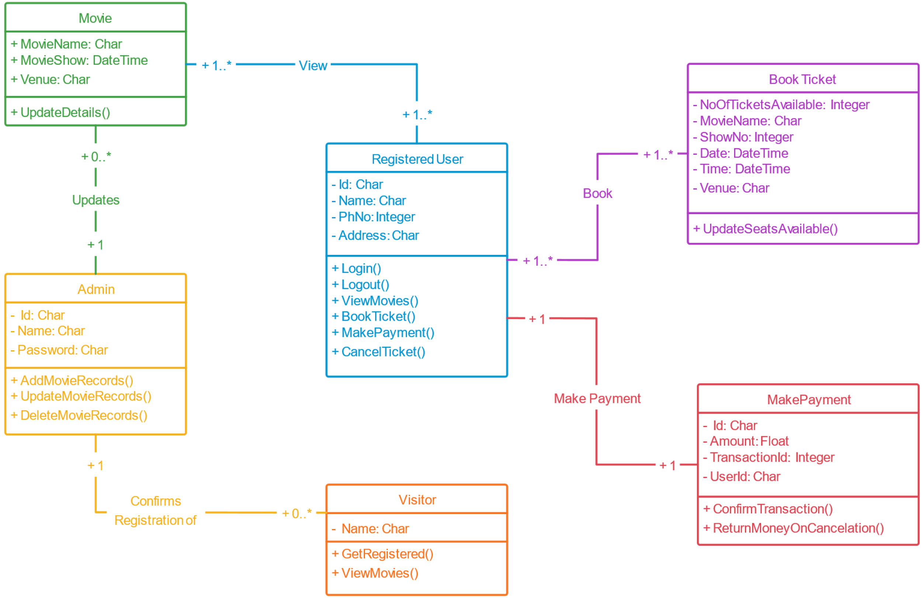
Proposal for Case Study

Slide 6
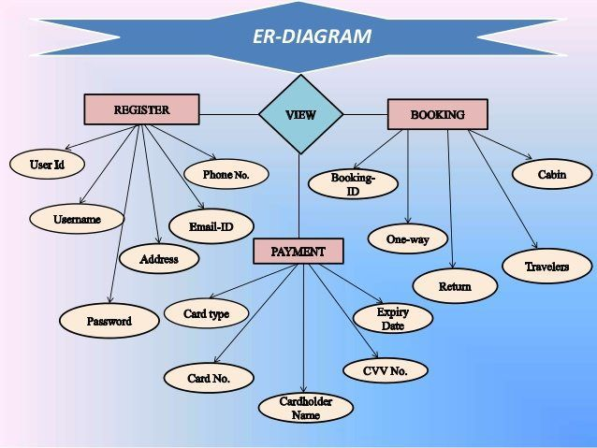
Input analysis of case study
User information (name, email address, contact information)
Event details (date, time, location, venue, performers)
Ticket type (general admission, reserved seating, VIP)
Payment information (credit card number, expiration date, billing address)
Output analysis of case study
E-ticket confirmation email
QR code for scanning at the event entrance
Physical ticket (if applicable)
Order confirmation page
Receipt for payment

Slide 7
Provide
Provide a convenient and efficient way for customers to purchase movie tickets.
Increase
Increase ticket sales and revenue for movie theaters.
Enhance
Enhance customer satisfaction and loyalty.
Reduce
Reduce operational costs and improve efficiency.
Collect
Collect valuable customer data for targeted marketing campaigns.
Objective of movie ticket booking system

Slide 8

𝐎𝐎𝐏𝐌 𝐂𝐀𝐒𝐄 𝐒𝐓𝐔𝐃𝐘
Ticket Booking System
Team Name – Visual programmers
Team Members – 3rd Sem
Leader Name : Sandeep Sen
Sandeep Sen 0131CS221172
Utkarsh Sahu 0131CS221219
Saurabh Sahu 0131CS221182

